Slide 1
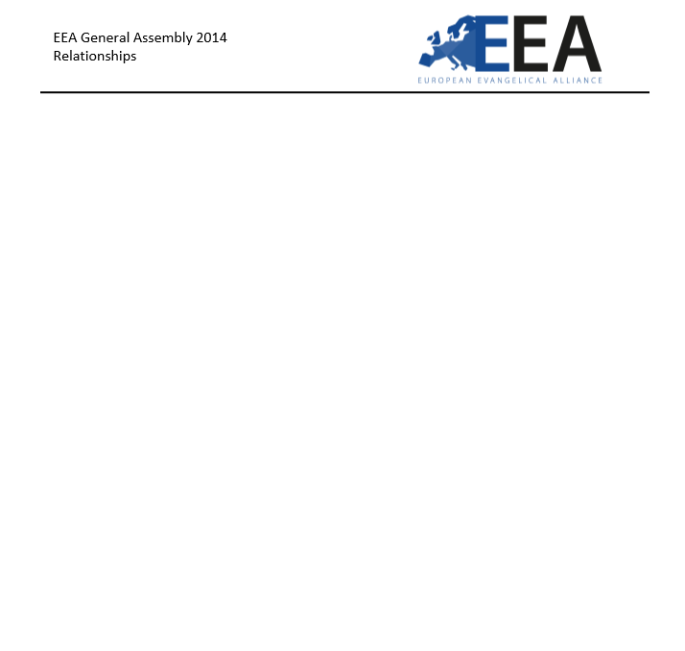
Quick Survey Findings of
Family Ministry in the EEA Church
Northampton, U.K. 21st October, 2014

Slide 2
What do you foresee the trend of breakdowns among the families in the church in the future?
Getting better ____
Getting worse____
Getting much worse____

Slide 3
EEA General Assembly 2014

Slide 4
How much emphasis do you think the church is giving to building healthy families in their midst?
Very little____
Some____
Much____
Very much____

Slide 5
EEA General Assembly 2014

Slide 6
How much is the church intentionally investing in finding out the needs (marriage, parenting, faith-building, human sexuality, aging care, etc.) of their families and meeting these adequately?
Very little____
Some____
Much____
Very much____

Slide 7
EEA General Assembly 2014

Slide 8
How much does the church intentionally equip the parents in passing on the faith to their children (all ages) at home?
Very little____
Some____
Much____
Very much____

Slide 9
EEA General Assembly 2014

