Slide 1
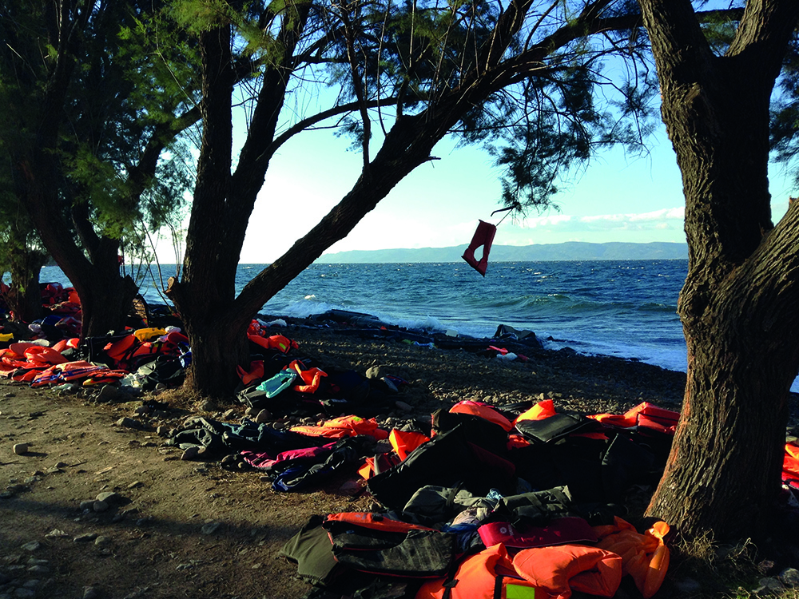
For I was hungry and you gave me food, I was thirsty and you gave me drink, I was a stranger and you welcomed me. Matthew 25:35

Slide 2
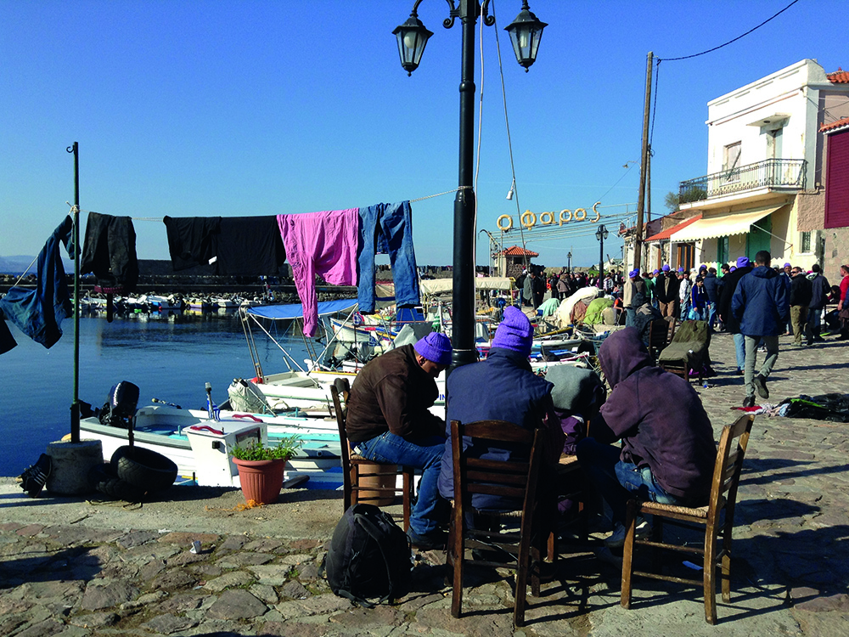
This is what the Lord Almighty said: Administer true justice; show mercy and compassion to one another. Do not oppress the widow or the fatherless, the foreigner or the poor. Do not plot evil against each other. Zechariah 7:9-10

Slide 3
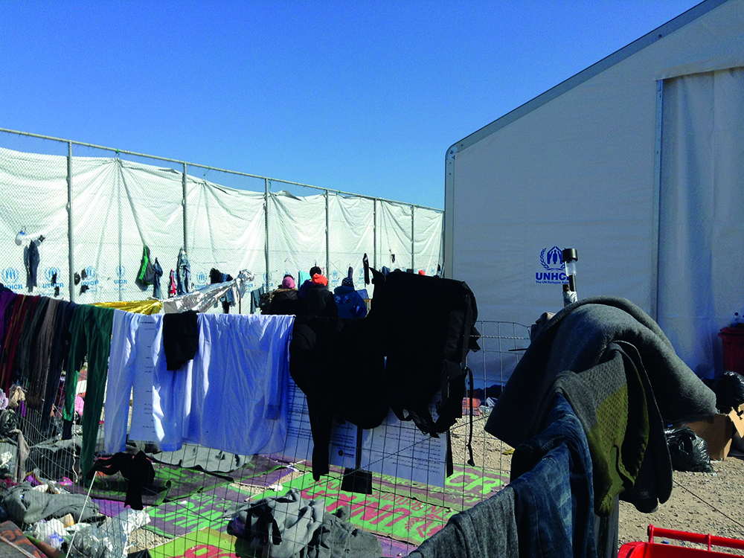

Slide 4
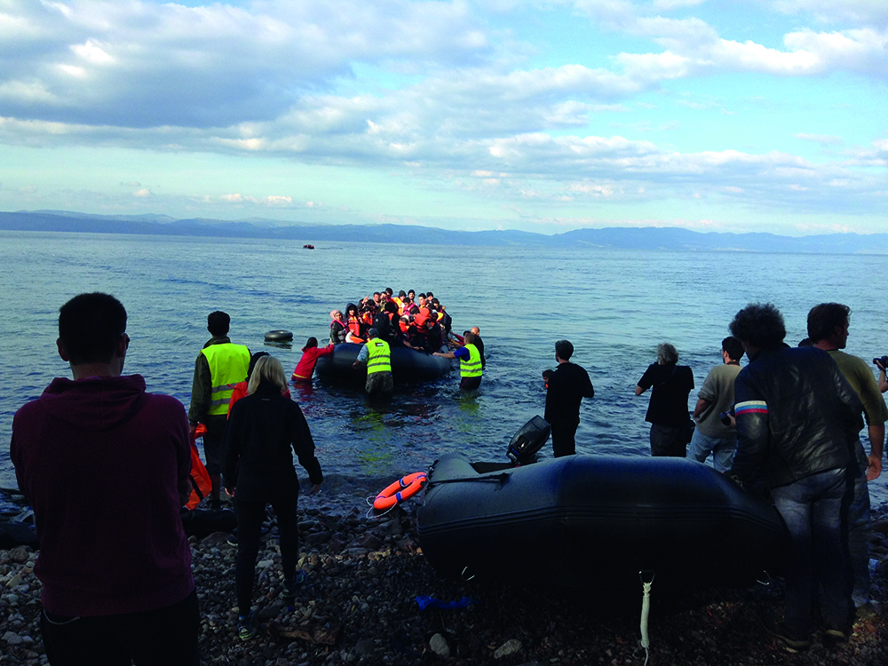
For I know the plans I have for you, declares the Lord, plans to prosper you and not to harm you, plans to give you hope and a future. Jeremiah 29:11

Slide 5
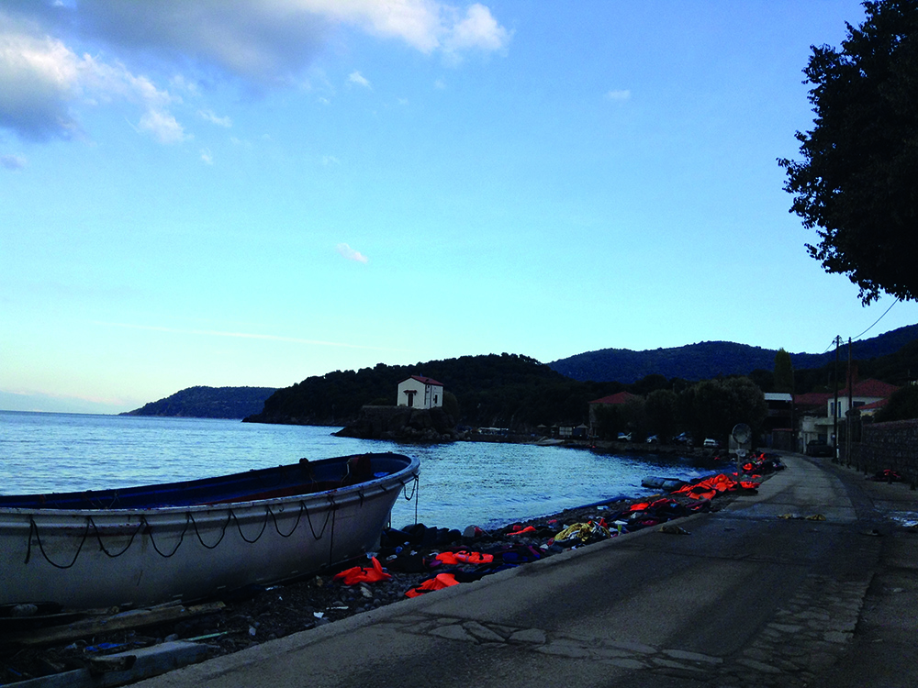

Slide 6
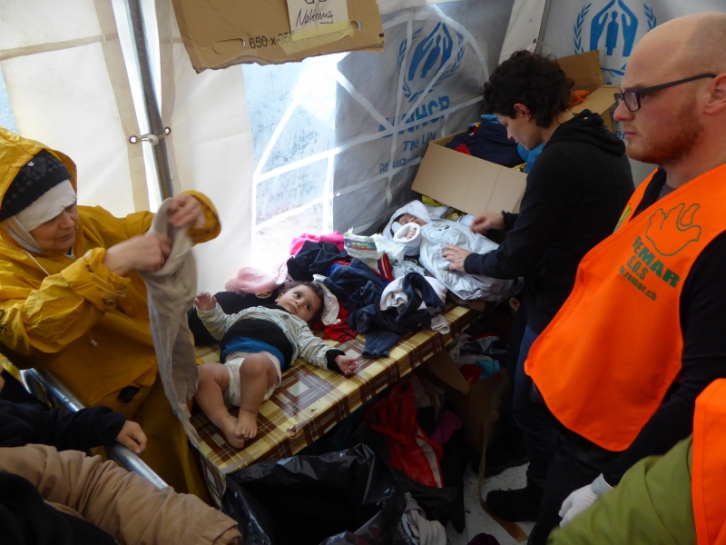
He defends the cause of the fatherless and the widow, and loves the foreigner residing among you, giving them food and clothing. And you are to love those who are foreigners, for you yourselves were foreigners in Egypt. Deuteronomy 10:18-19

Slide 7
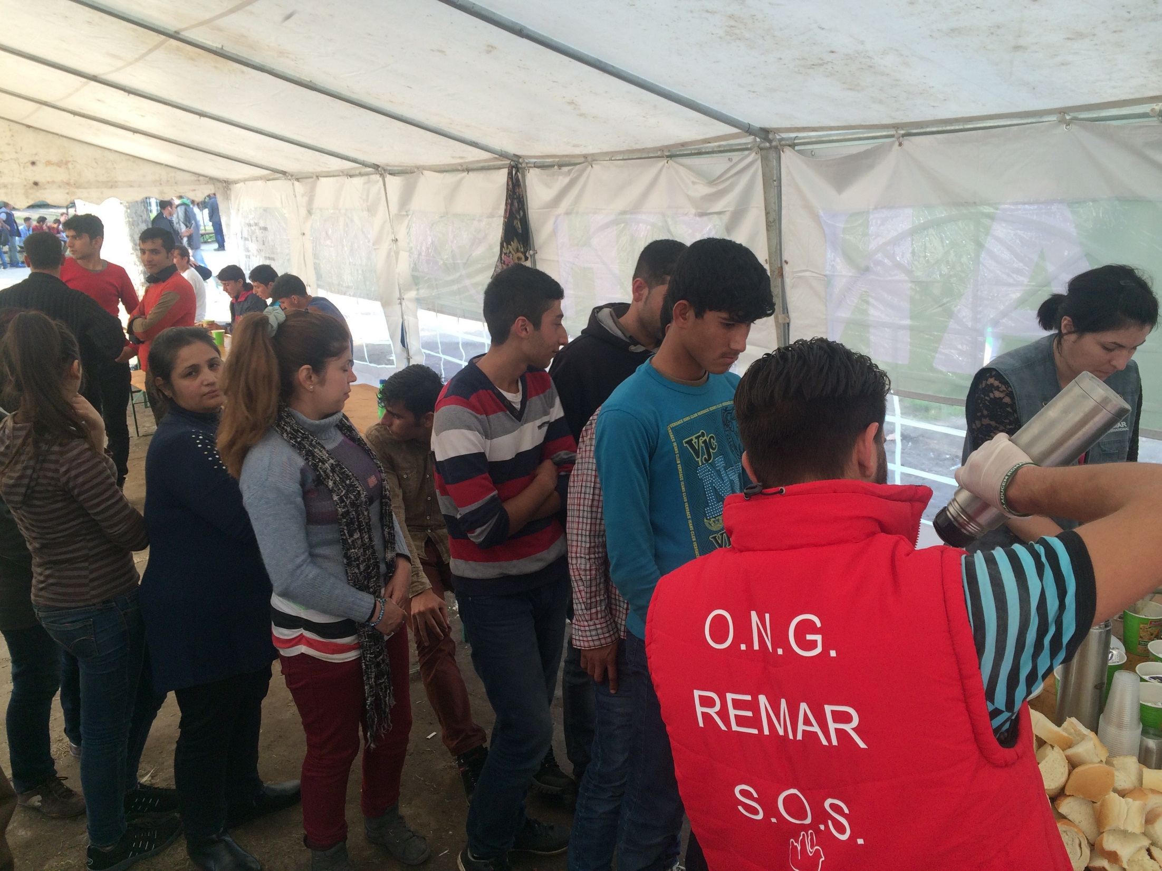

Slide 8
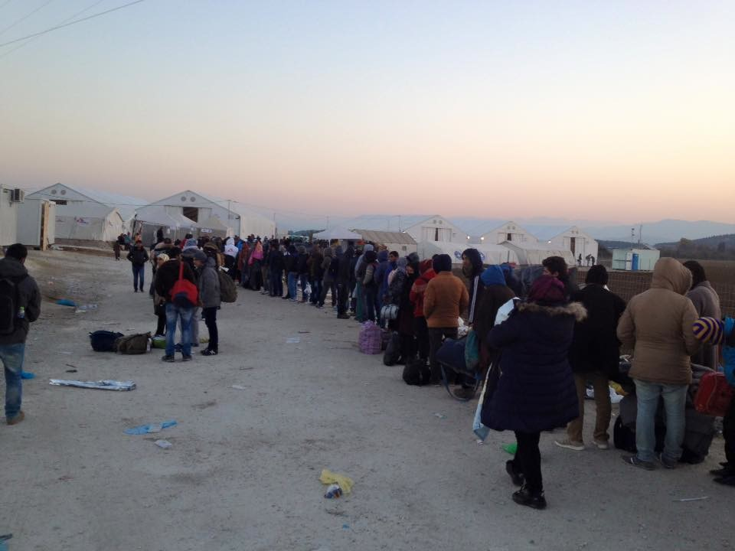
For my eyes have seen your salvation, which you have prepared in the sight of all nations: a light for revelation to the Gentiles, and the glory of your people Israel. Luke 2:30-32

Slide 9
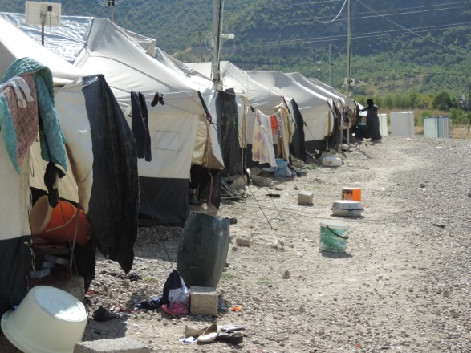
I have great sorrow and unceasing anguish in my heart. For I could wish that I myself were cursed and cut off from Christ for the sake of my people, those of my own race. Romans 9:2-3

Slide 10
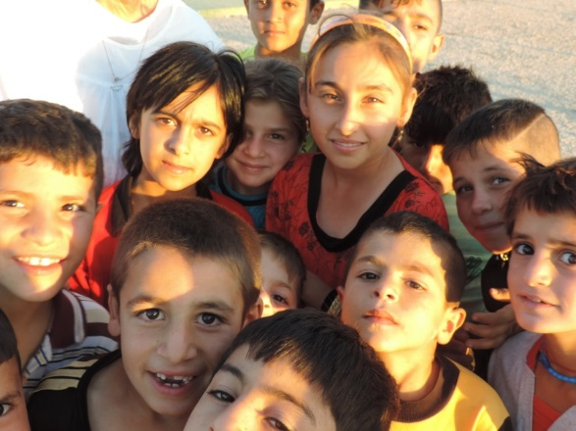

Slide 11
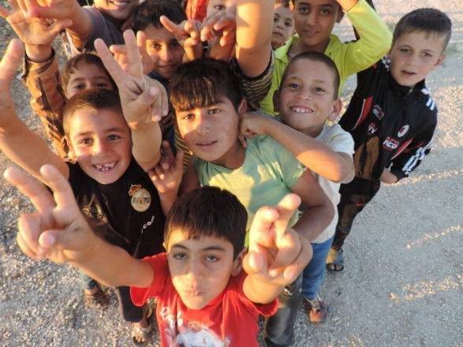
My goal is that they may be encouraged in heart and united in love, so that they may have the full riches of complete understanding, in order that they may know the mystery of God, namely, Christ.
Colossians 2:2

Slide 12
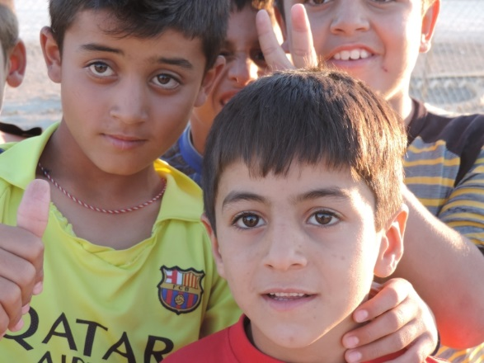

Slide 13
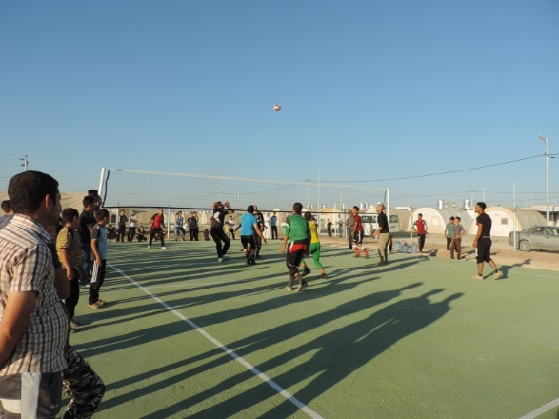
The kingdom of heaven is like treasure hidden in a field. When a man found it, he hid it again, and then in his joy went and sold all he had and bought that field. Matthew 13:44

Slide 14
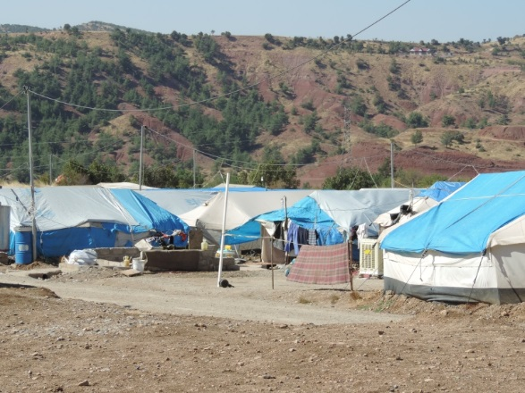
But while he was still a long way off, his father saw him and was filled with compassion for him; he ran to his son, threw his arms around him and kissed him. Luke 15:20b

Slide 15
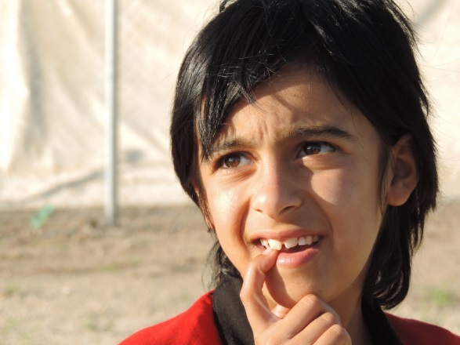

Slide 16
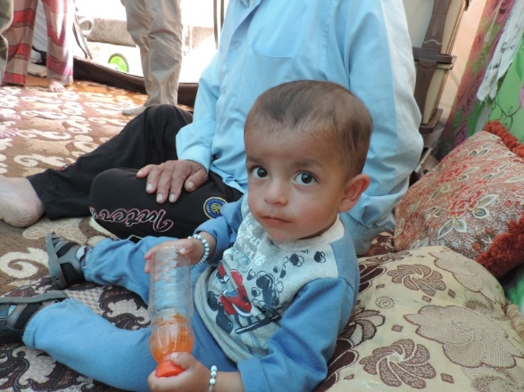
Therefore, since we are receiving a kingdom that cannot be shaken, let us be thankful, and so worship God acceptably with reverence and awe. Hebrews 12:28

Slide 17
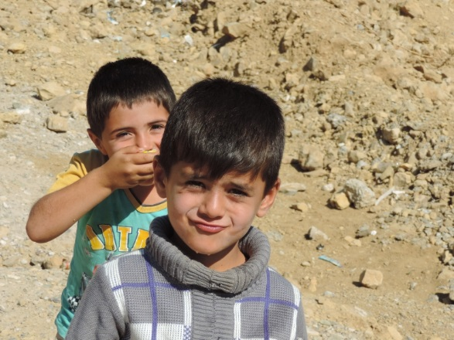

Slide 18
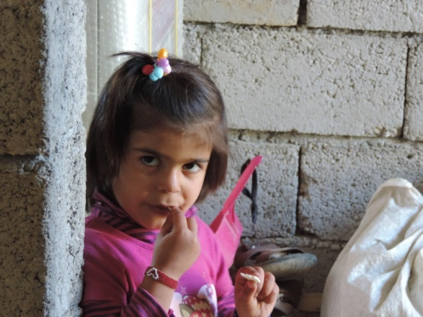
I pray that the eyes of your heart may be enlightened in order that you may know the hope to which he has called you, the riches of his glorious inheritance in his holy people. Ephesians 1:18

