Slide 1


Slide 2



Slide 3


Slide 4
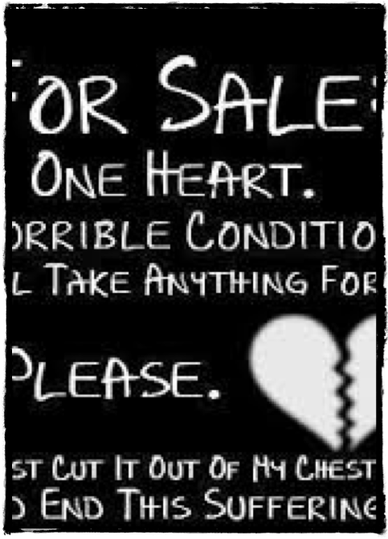


Slide 5
Gathered
Radical word
Radical prayer
Radical sacrifice
Radical gratitude
Radical leadership
Radical growth

Slide 6
Scattered
Family
Community
City
Workplace

Slide 7



Slide 8
Your dream for your church
Your biggest encouragement
Your biggest challenge
Your big idea

