Slide 1
New wine
Old wineskins
Luke 5 v

Slide 2
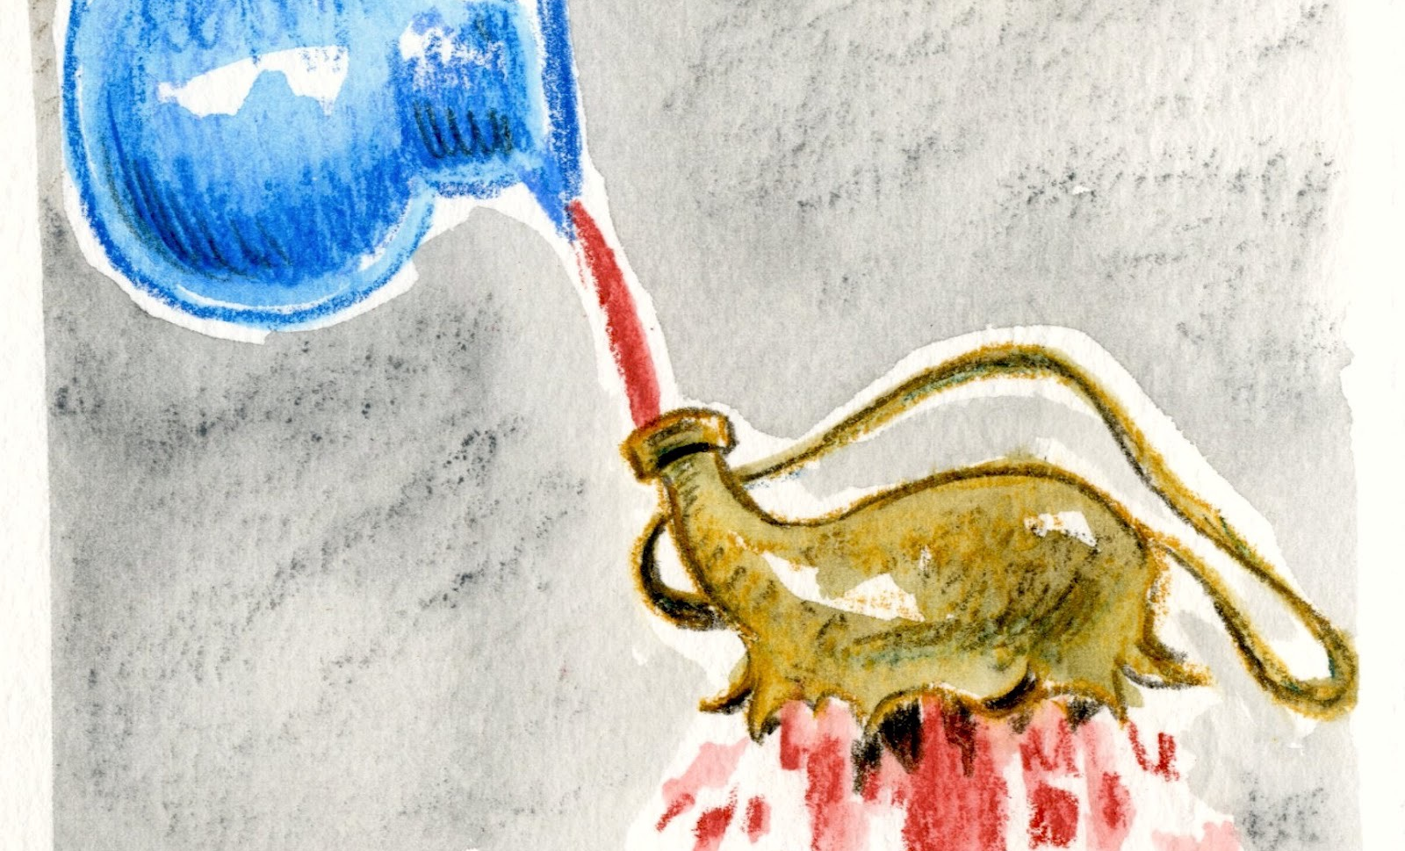
A positional shift

Slide 3

A threshold time

Slide 4


Slide 5


Slide 6
Where are the threshold points for you?
Are there places where we are uncertain of the way forward?
Threshold can be a place of dream and possibility- what is your dream for your church?
What is your primary mission opportunity

