Slide 1

A church response?

Slide 2

Psalm 137

Slide 3
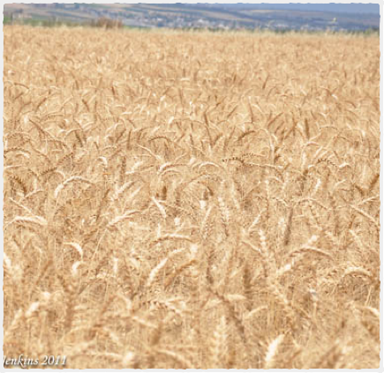
Mission and church
Asking the right questions
Mission is God's
It is an atmosphere/ characteristic Not an event or programme

Slide 4
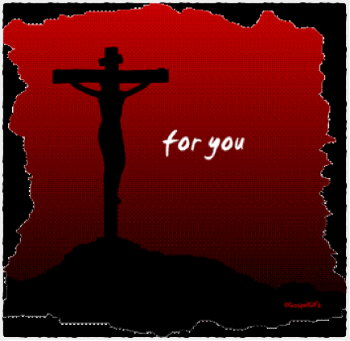
Encounter and Engagement
The impact of the disciples was based solely on their conection to Jesus.
What I have I give to you. In the name of Jesus Christ of Nazareth. Get up and walk,

Slide 5
Shaped by the word
School competition
Scripture unleashed

Slide 6
Community of fellowship
Taking fellowship out
Community in the street/ opeb

Slide 7
Sacrificial community
Blessing the community
Give stuff away

Slide 8
Dynamic community
Unleash the gospel on the streets
Identify the prophets and evangelists

Slide 9

