Slide 1
Living as people of God in Europe, which is being reshaped by Islam

Slide 2

Living as
people of God
in Europe,
which is being reshaped by Islam
Timo Keskitalo

Slide 3
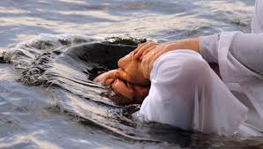
Living as people of God in Europe, which is being reshaped by Islam
Conversion

Slide 4
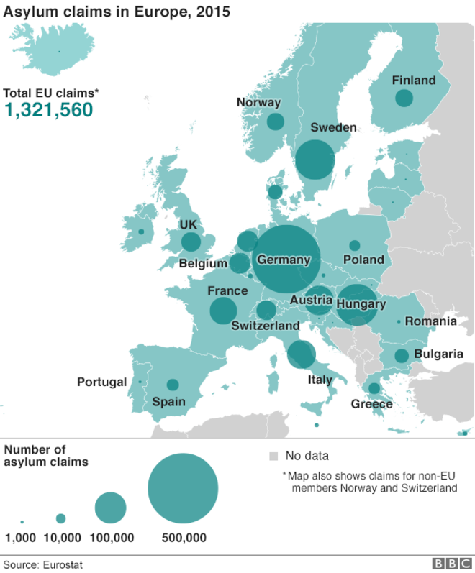
Living as people of God in Europe, which is being reshaped by Islam
Migration

Slide 5
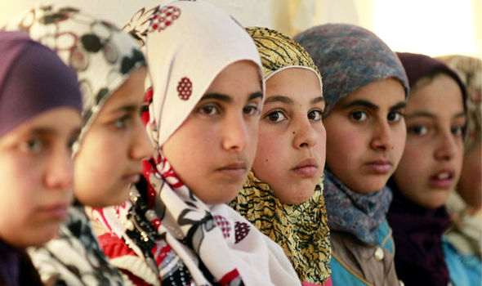
Living as people of God in Europe, which is being reshaped by Islam
Family demographics

Slide 6
Living as people of God in Europe, which is being reshaped by Islam
Forced to react
Freedom of speech
Theological changes
Church
Marriage
Security
Political map

Slide 7
Living as people of God in Europe, which is being reshaped by Islam
How do we see ourselves as Evangelical Christians
in Europe?

Slide 8
Living as people of God in Europe, which is being reshaped by Islam
Doctrine of two kingdoms as
a key for discerning

Slide 9
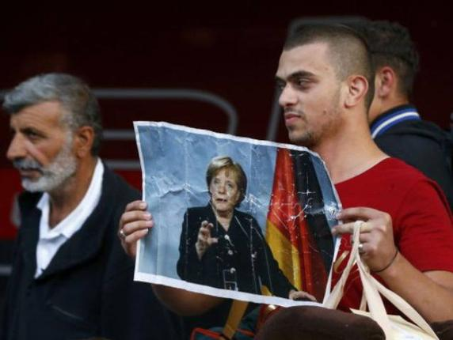
Living as people of God in Europe, which is being reshaped by Islam
Faith using politics

Slide 10

Living as people of God in Europe, which is being reshaped by Islam
Politics using faith

Slide 11
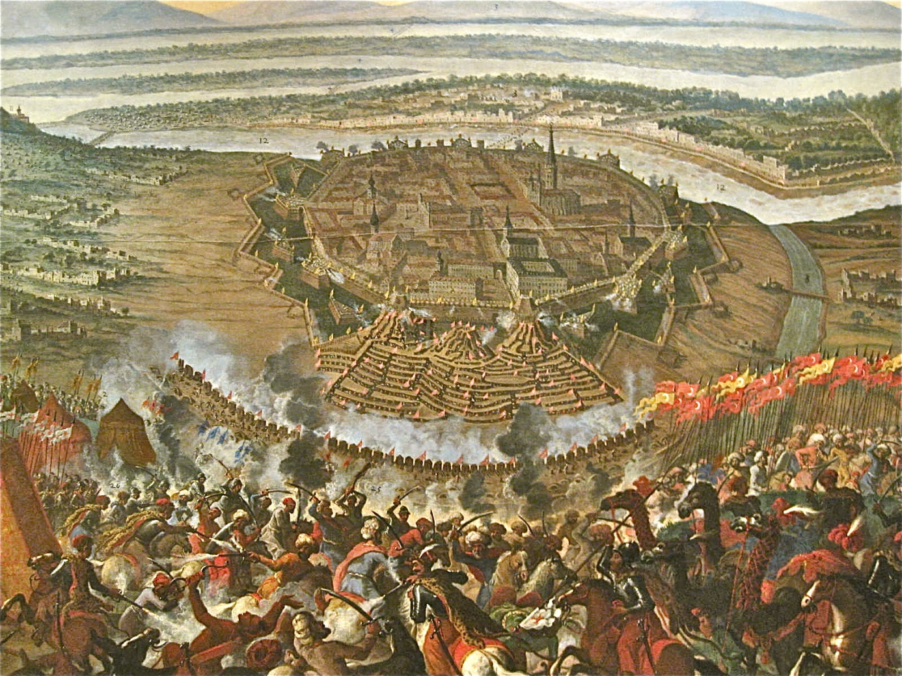
Living as people of God in Europe, which is being reshaped by Islam
Faith and politics mixed

Slide 12
Living as people of God in Europe, which is being reshaped by Islam
A mighty fortress is our God, Martin Luther
“Let goods and kindred go,
This mortal life also;
The body they may kill:
God’s truth abideth still,
His kingdom is forever.”

Slide 13
Living as people of God in Europe, which is being reshaped by Islam
How to encounter fear?

Slide 14
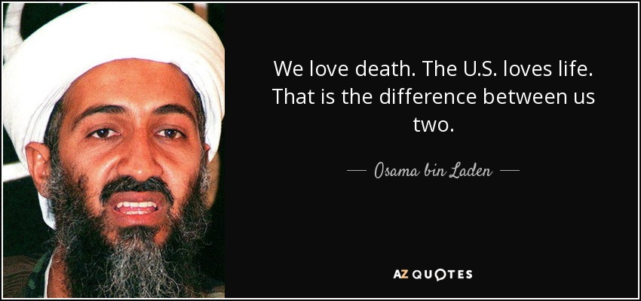
Living as people of God in Europe, which is being reshaped by Islam

Slide 15
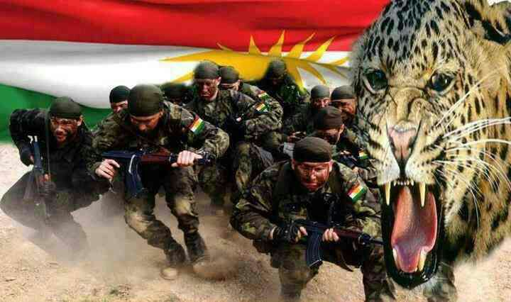
Living as people of God in Europe, which is being reshaped by Islam
Peshmerga

Slide 16
Living as people of God in Europe, which is being reshaped by Islam
“perfect love
drives out fear”
1 John 4:18

Slide 17
Living as people of God in Europe, which is being reshaped by Islam
Who should
pay the price?

Slide 18
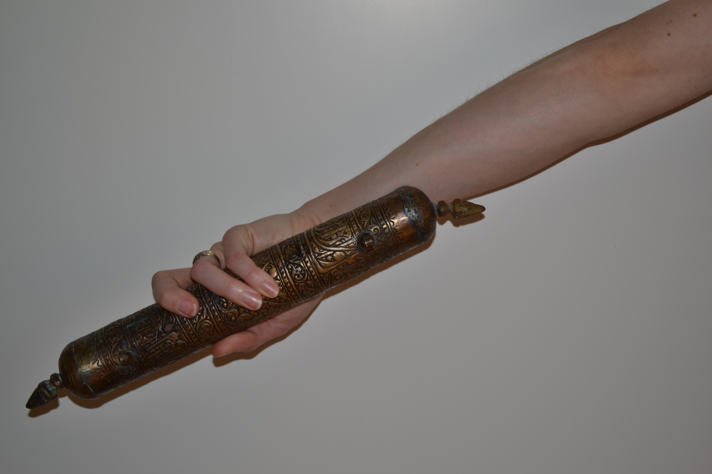
Living as people of God in Europe, which is being reshaped by Islam

Slide 19

Living as people of God in Europe, which is being reshaped by Islam

Slide 20
Living as people of God in Europe, which is being reshaped by Islam
The apostles were “rejoicing, because they had been counted worthy of suffering disgrace for the name”
Acts 5:41

Slide 21
Living as
people of God
in Europe,
which is being reshaped by Islam
Timo Keskitalo

Slide 22
Living as people of God in Europe, which is being reshaped by Islam

